Slide 1
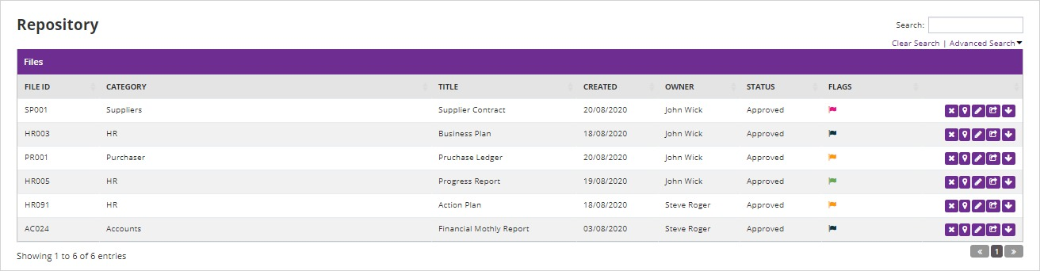
YOUR REPORSITORY WITH DOCUMENTS AVAILABLE TO YOU ONLY

Slide 2
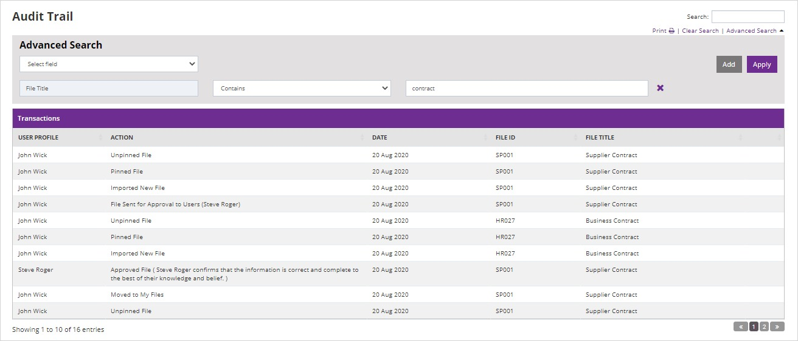
WHO DID
WHAT,
WHEN &
WHERE

Slide 3
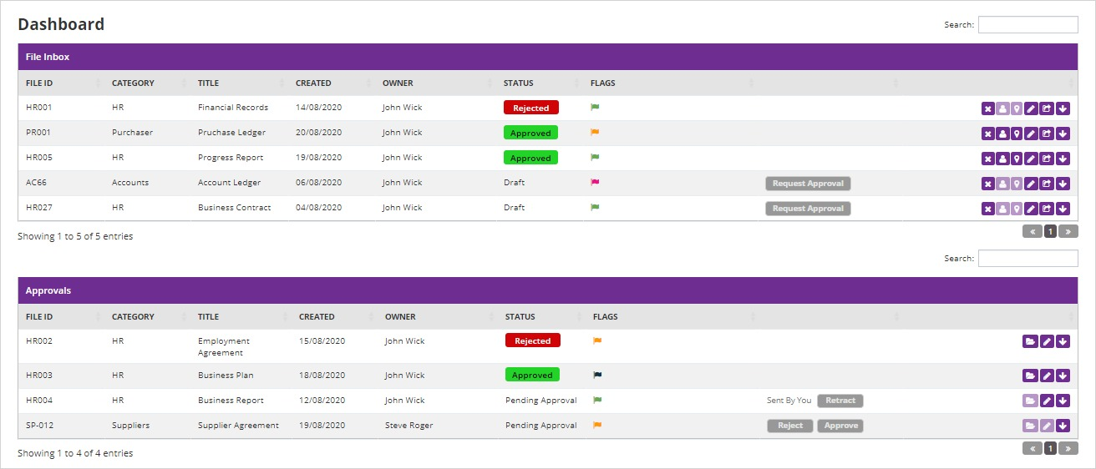
DASHBOARD OF DOCS
TO BE APPROVED
OR REJECTED

Slide 4
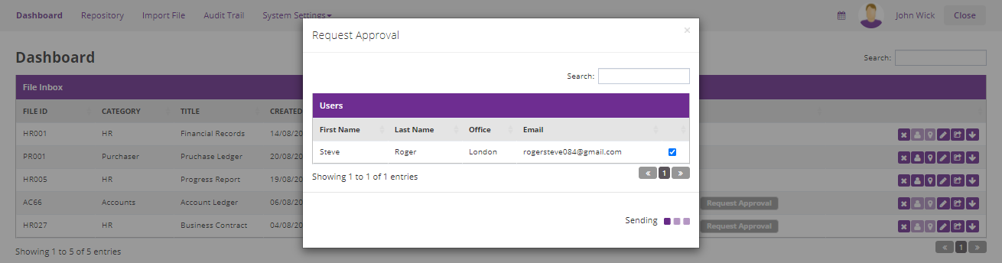
WHO IS THE APPROVER? REQUEST FOR APPROVAL

Slide 5
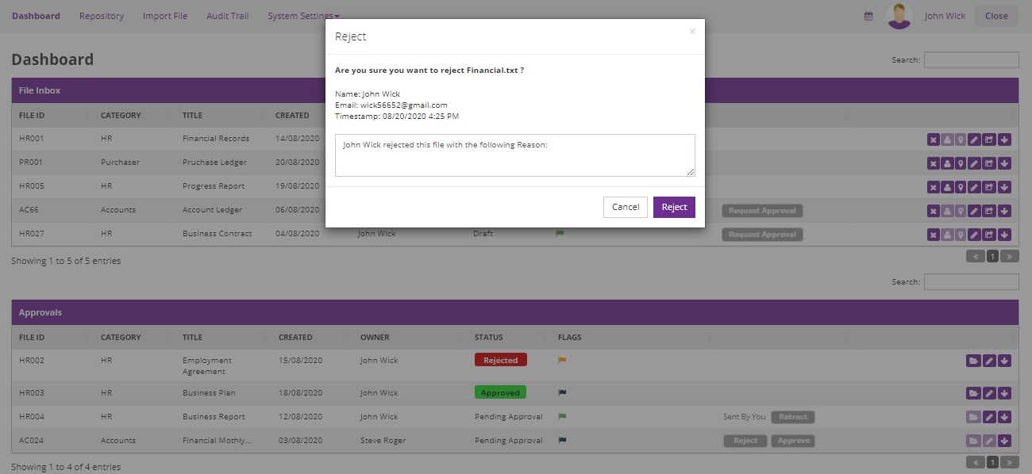
APPROVER REJECTS WITH REASON

Slide 6
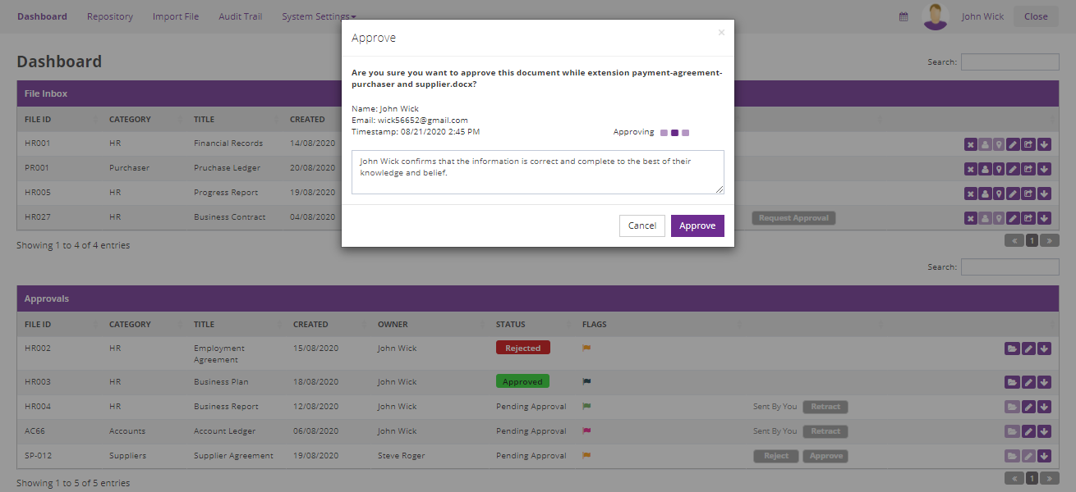
APPROVER
APPROVES
DOCUMENT WITH NOTES

Slide 7
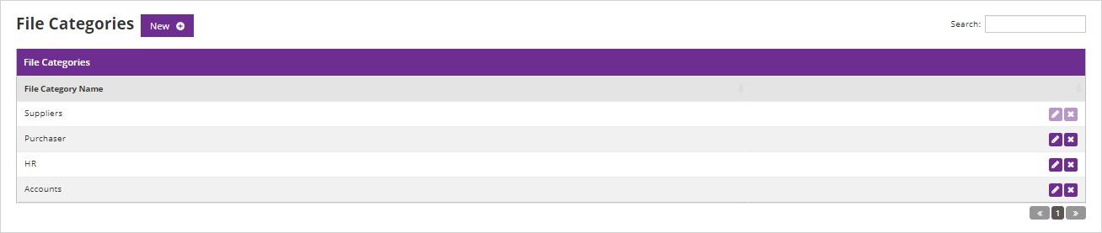
CREATE YOUR OWN DOCUMENT CATEGORIES

Slide 8
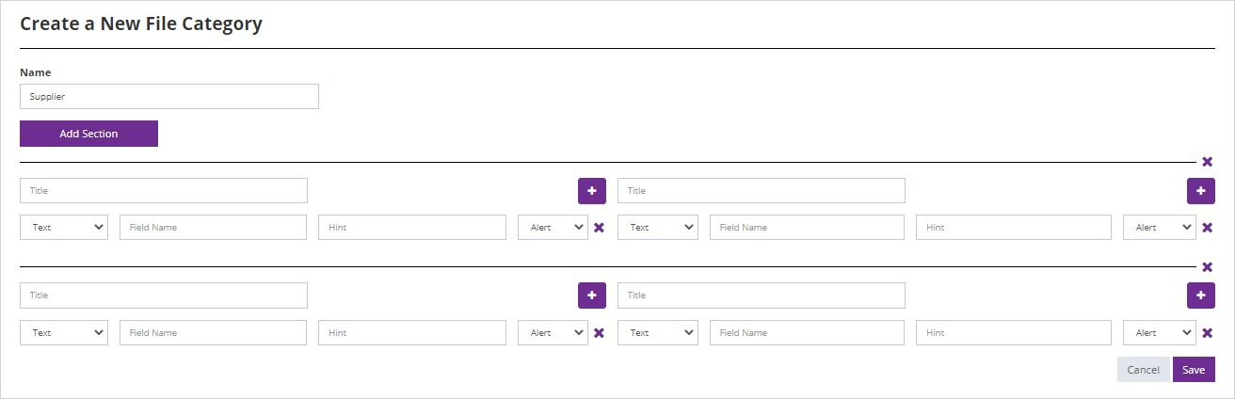
ADD TITLES AND UNIQUE REFERENCES FOR EASY RETRIEVAL

Slide 9
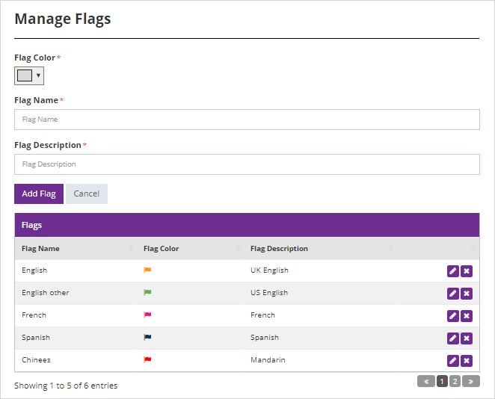
FLAGS GIVE YOU ANOTHER SERCH FIELD. PERHAPS OFFICE GENERATED

Slide 10
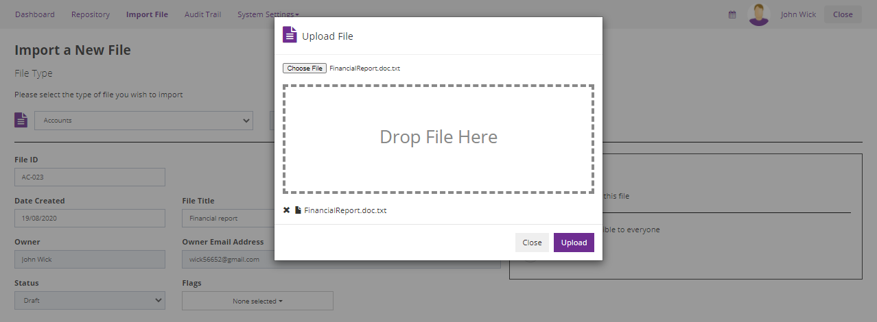
IMPORT A DOCUMENT

Slide 11
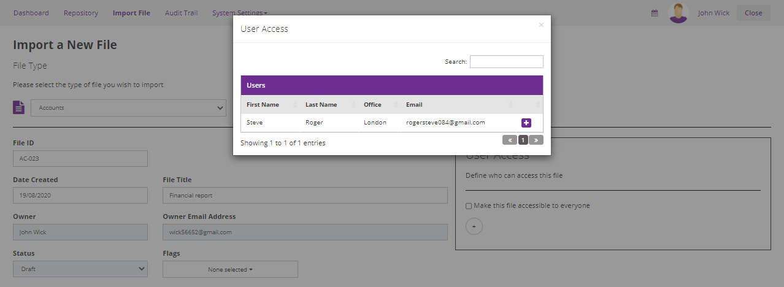
GIVE ACCESS RIGHTS OR LET DOCUMENT BE SEEN BY ALL

